Slide 1
Developing Integration Solutions using Microsoft BizTalk Server 2009
Installing and configuring

Slide 2

Course Outline
Module 1: Introduction to BizTalk Server
Module 2: Schemas
Module 3: Maps
Module 4: Testing and Deploying BizTalk projects
Module 5: Pipelines
Module 6: Routing
Module 7: Adapters
Module 8: Web Services and WCF
Module 9: Introduction to Orchestrations
Module 10: Applied Orchestration Techniques
Module 11: Business Rules
Module 12: Deploying and Managing Applications
Module 13: Business Activity Monitoring
Module 14: Installing and configuring
Lesson 1: Installing and configuring

Slide 3
Lesson 1: Installing and configuring BizTalk
Choosing the right edition
Installing and Configuring BizTalk Server
Hosts and Host Instances
Databases

Slide 4
Editions
 | Enterprise | Standard | Branch | Developer
License | Per processor basis | Per processor basis | Per processor basis | Per user basis
Price per processor | $35.000 | $8.500 | $1.800 | $500 per user
Applications | Unlimited | Five | One | Unlimited
Failover support | Yes | No | No | Non-production
64 Bit Support | Yes | No | Yes | Yes
Maximum Processors | Unlimited | Two | Two | Not Applicable
Virtual Processors | Unlimited | - | - | -
Designed for customers with enterprise-level requirements for high volume, reliability, and availability
Designed for businesses with moderate volume and deployment scale requirements
Specialty version of BizTalk Server designed for hub and spoke deployment scenarios including RFID
For development and testing purposes, and use BizTalk Server 2009 Evaluation Edition (EVAL) is free for evaluation purposes

Slide 5
System requirements – BizTalk Server 2009
Minimum hardware requirements
Minimum software requirements
1 GHz Intel Pentium compatible CPU
32-bit
2 GB of RAM
10 GB of available hard disk space
Windows Server 2003
SQL Server 2005 Std
BizTalk pre-requisite CAB file
Recommended hardware
Recommended software
1 (or more) Quad core processor
64-bit
4 GB or more of RAM
45+15 GB or more available hard disk space
Windows Server 2008 Ent SP2
SQL Server 2008 SP1 Std

Slide 6

Contents of the Pre-requisite CAB file
BTS2009Redist cab
Microsoft Office 2003 Web Components (OWC11) Version 4
Microsoft Data Access Components (MDAC) 2.8 SP1
Microsoft XML Core Services (MSXML) 6.0 with SP1
Microsoft .NET Framework 3.5 SP1
SQLXML 4.0 SP1
ADOMD.NET 9.0
ADOMD.NET 10
There are both 32-bit and 64-bit versions available.

Slide 7
Optional Software
Development
Optional Software
EDI, BAM Portal, WSS Adapter, UDDI
Microsoft Visual Studio® 2008
Microsoft Internet Information Services (IIS) 6.0 or 7.0
Windows SharePoint Services 3.0 SP1
Microsoft Office SharePoint Server 2007 (MOSS)
Microsoft Office Excel 2007
SQL Server Integration Services
SQL Server 2005 Notification Services
WSS Adapter
BAM

Slide 8
Basic steps for Installing BizTalk Server on stand-alone server
1
2
Install Windows
Install SQL Server
4
Install BizTalk Server
5
Configure BizTalk
7
Verify and test you installation
3
Download BizTalk pre-req CAB
Ensure user rights
6

Slide 9
Basic steps for Installing BizTalk Server in a multi-server environment
1
2
Install Windows on all servers
Install SQL Server on db servers
3
Configure MSDTC
4
6
Install BizTalk on app servers
Verify MSDTC and db connectivity
7
Configure BizTalk
9
Verify and test you installation
5
Download BizTalk pre-req CAB
Configure and verify AD users, groups and rights
8

Slide 10
Basic steps for Installing BizTalk Server on Development machine
1
Install SQL Server
4
Install and configure BizTalk Server
5
Verify and test you installation
3
Download BizTalk pre-req CAB
2
Install Visual Studio, Excel, MMC 3.0 and other optional components

Slide 11
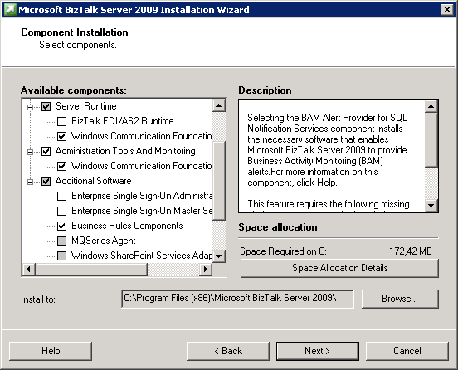
Choosing BizTalk Server Features and Components
Documentation
Server Runtime
EDI/AS2 Runtime
Windows Communication Foundation (WCF) Adapter Runtime
Portal Components
Administration Tools and Monitoring
Windows Communication Foundation (WCF) Administration Tools
Developer Tools and SDK
Additional Software
Enterprise Single Sign-On (SSO) Administration Module
Enterprise Single Sign-On Master Secret Server
Business Rules Components
MQSeries Agent
Windows Sharepoint Services Adapter Web Service
BAM Alert Provider för SQL Notification Services
BAM Client
BAM Eventing
Project Build Component
Notes:
Documentation
Core documentation, tutorials, UI reference (F1 Help), programmer’s reference, and usage instructions for the SDK samples and utilities.
Server Runtime
The essential runtime services for BizTalk Server.
BizTalk EDI/AS2 Runtime
Runtime services providing native support for Electronic Data Interchange (EDI) data exchange and AS2 (Applicability Statement 2) data transport messaging functionality.
Windows Communication Framework (WCF) Adapter Runtime
Adapters enabling BizTalk Server to communicate with WCF-based applications.
Portal Components
Also known as Business Activity Monitoring (BAM), these are a set of services enabling users to communicate and collaborate, and also to configure and monitor business processes and workflows.
Administrative Tools
Software necessary to administer BizTalk Server on both the local computer and a remote server.
Windows Communication Framework (WCF) Administration Tools
Administration services for WCF components.
Developer Tools and SDK
Samples and utilities that enable the rapid creation of BizTalk Server 2009 solutions. This includes SDK samples and supporting documentation, BizTalk Explorer, schema and map designers, and Visual Studio project templates.
Additional Software The following components enable a more flexible BizTalk deployment:
· Enterprise Single Sign-On (SSO) Administration Module: The interface for managing SSO Affiliate Applications and their mappings.
· Enterprise Single Sign-On Master Secret Server: The SSO server that stores the master secret. All other SSO servers in the system get the master secret from this server. The Master Secret Server is required in a BizTalk Server environment.
· Business Rules Components: Used for composing policies to be consumed by the Business Rules Engine.
· MQSeries Agent: Provides communication between the BizTalk Adapter for MQSeries and MQSeries Server for Windows.
· Windows SharePoint Services Adapter Web Service: Allows the Windows SharePoint Services Adapter to process incoming and outgoing documents through Windows SharePoint Services.
· BAM Alert Provider for SQL Notification Services: Allows BAM Alerts.
· BAM Client: Client-side software enabling business users to work with BAM.
· BAM Eventing: Interceptors for Windows Workflow Foundation and Windows Communication Foundation. Also includes the BAM Event API, which sends events to the BAM database from custom applications.
· Project Build Component: A tool enabling you to build BizTalk Server solutions without using Visual Studio.

Slide 12
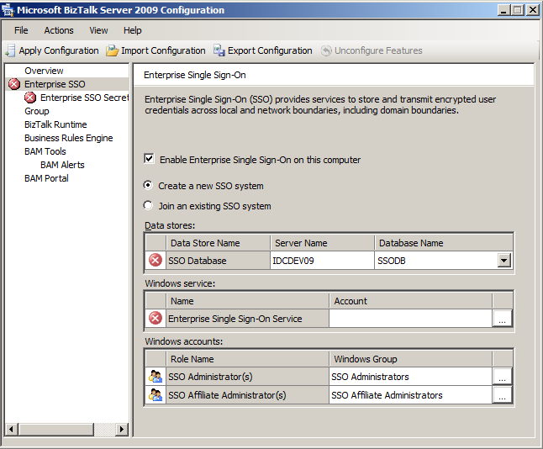
Configuring BizTalk Server
Enterprise SSO
Name and location of database, SSODB
Account name of SSO Service
SSO Administrators group and SSO Affiliate Administrators group
Enterprise SSO Secret Backup
Group
Name and location of databases
BizTalkMgmtDb, BizTalkMsgBoxDb, BizTalkDTADb
BizTalk Administrators and BizTalk Operators groups
BizTalk Runtime
Host names and accounts, BizTalk Host Instance and BizTalk Isolated Host Instance
BizTalk Host Users and BizTalk Isolated Host User groups
Other
Business Rules
BAM Tools, Alerts and Portal

Slide 13


Hosts and Host instances
BizTalk Group
Logical Hosts
Physical Servers
Host1
BizTalk databases
Server1
ReceiveHandler 1
Host Instance 1
ReceiveHandler 2
Host Instance 2
Host2
SendHandler FILE
Server2
SendHandler …
Host Instance 1
Host to Server mapping
Host Instance 2
Separation of concerns!
Receive, Send, Process, Tracking should be separated in individual hosts, as should trusted and non-trusted items, 32 and 64 bit.

Slide 14
Isolated Hosts and Host Instances
Represent handling of adapters that run in external processes - outside the BizTalk Server Runtime
For example WCF-BasicHttp
Receive only
Cannot do tracking
Always has Status Unavailble status.
One external process can host only one type of adapter

Slide 15
BizTalk Server Databases
BizTalk Server Runtime databases
Business Rules databases
SSO database
BizTalk Management database
BizTalk MessageBox database(s)
BizTalk Tracking database
Rule Engine database
Business Activity Monitoring databases
BAM Primary Import
BAM Archive
BAM Analysis
BAM Notification Service Application
BAM Notification Services Instance
BAM Star Schema

Slide 16
Lesson 2: SCALING
Scaling Hosts and Databases
Verifying the performance of your installation

Slide 17
Scaling BizTalk Server
Scale-up
All servers can be scaled up
Usually first choice on database level
Add memory, add processor, ensure disk capacity
Scale-out
All servers can be scaled out
Primarily application servers, especially when virtualized
Additional database servers can be added as well
When do we reach the limit?
Master MessageBox database saturation or
Tracking database saturation
Why is that a limit?
The database is core
It’s about reliability
?

Slide 18


Scaling out BizTalk – Single Server
BT
BizTalk Group
Isolated Hosts
Isolated Host
In-process Hosts
Orchestrations
Receive
Send
Tracking
Master Secret
(EntSSO)
Isolated
Host instance
In-Process Host instance
BizTalk Server Databases

Slide 19


Scaling out BizTalk – Basic Scale-out
BT
BizTalk Group
Isolated
Host instance
In-process
Host instance
Isolated
Host instance
In-process
Host instance
SQL Server Active/Passive Cluster
Master Secret Service
Master Secret Service
MessageBox database
MessageBox database
Tracking database (DTA)
Tracking database (DTA)
Other BizTalk databases
Other BizTalk databases

Slide 20




Scaling out BizTalk – Scale-out For High Throughput
BT
Requirers Win Enterprise Edition
BizTalk Group
Isolated
Host instance
In-process
Host instance
Isolated
Host instance
In-process
Host instance
Isolated
Host instance
In-process
Host instance
Isolated
Host instance
In-process
Host instance
SQL Server Active/Active Cluster
Master Secret Service
Master Secret Service
MessageBox database
MessageBox database
Tracking database (DTA)
Tracking database (DTA)
Other BizTalk databases
Other BizTalk databases

Slide 21
Scaling out BizTalk – Scale-out For High(er) Throughput
BT
BizTalk Group
Isolated
Host instance
In-process
Host instance
Isolated
Host instance
In-process
Host instance
Isolated
Host instance
In-process
Host instance
Isolated
Host instance
In-process
Host instance
SQL Server Active/Active/Passive Cluster
Master Secret Service
Master Secret Service
Other BizTalk databases
Other BizTalk databases
MessageBox1 database
MessageBox1 database
MessageBox2 database
MessageBox2 database
MessageBox3 database
MessageBox3 database
Tracking database (DTA)
Tracking database (DTA)

Slide 22
Planing BizTalk Hosts and Host instances
BizTalk Server 1
BizTalk Server 2
BizTalk Server 3
Default Receive 32
Default Receive 32
Default Receive 64
Default Receive 64
Default Send 32
Default Send 32
Default Send 64
Default Send 64
Clustered Receive 32
Clustered Receive 32
Clustered Receive 64
Clustered Receive 64
Orchestrations
Orchestrations
Tracking
Tracking
Tracking

Slide 23

Verifying your BizTalk installation
Baseline performance!
500 Msgs/second – Stand-alone BizTalk machine using passthrough pipeline with file adapter
Actual performance?
That depends!
Message size/complexity/validation/transformation, performance of developed code and orchestrations, level of tracking and logging, protocols and adapters... Disk and SQL Server!
You mean you can’t tell us?
If you get the exact same blade servers, the exact same processors, memory, virtualization, SAN, backup and restore, local disks, networking etc. etc. as customer X, and also do the same types of messaging and processing - we can!
Customer X does 1200 messages a day, ranging between 10KB and 500MB.
Customer Y does 500 000 messages a day, all below 3KB.
Test is key!
Monitoring is key!

Slide 24
Verifying your BizTalk installation
BizTalk Server 2009 Performance Optimization Guide
The BizTalk Server 2009 Performance Optimization Guide provides prescriptive guidance on the best practices and techniques that should be followed to optimize BizTalk Server performance.
Performance Analysis of Logs (PAL) Tool
The PAL (Performance Analysis of Logs) tool is a powerful tool that reads in a performance monitor counter log and analyzes it to known thresholds.
Microsoft BizTalk LoadGen 2007 Tool
Microsoft BizTalk LoadGen 2007 is a tool that is used to run performance and stress tests.
BizTalk Benchmark Wizard
The goal has been to make an easy to install and simple to use, wizard-like application with which one could test a BizTalk environment – and compare the result to the The BizTalk Server 2009 Scale Out Testing Study

Slide 25
Summary
Xxx

Slide 26
Q & A
Installing and configuring

Slide 27


Hands-On-Labs

Slide 28

Quiz
Xxx

